Slide 1
MEASURES OF DISPERSION
Measures of central tendency (mean, median, mode, GM and HM) do not provide all information about the observations contained in a data set that how the individual observations are scattered around the central value. It is possible with the help of measures of dispersion.
A single value which measure that how the individual observations of a data set are scattered/dispersed around the central value, is called measure of dispersion. Measures of dispersion are classified as “Absolute measures” and “Relative measures” of dispersion.

Slide 2
MEASURES OF DISPERSION
Measures of
Dispersion
Absolute Measure of
Dispersion
Relative Measure of
Dispersion
A type of dispersion which can be expressed in the same unit of measurement in which the original series/data set/ distribution is given, is called “Absolute measure” of dispersion. For example, Range, Quartile deviation, Mean deviation, Standard deviation etc. Similarly, a type of dispersion which is independent of unit of measurement is called “Relative measure” of dispersion. For example, coefficient of range, coefficient of quartile deviation, coefficient of mean deviation, coefficient of variation etc.

Slide 3
COMMONLY USED MEASURES OF DISPRSION
Absolute Measures of Dispersions
Range
Inter quartile range
Semi inter quartile range or Quartile Deviation (QD)
Mean deviation
Variance and
Standard deviation
Relative Measures of Dispersions
Coefficient of Range
Coefficient of Inter quartile range
Coefficient Semi inter quartile range
Coefficient Mean deviation
Coefficient of Variation

Slide 4
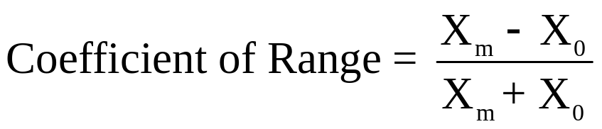
Range and Its Coefficient
Range is an absolute measure of dispersion. “It is the difference between maximum (X_{m}) and minimum (X₀) values of a data set”. Mathematically, range is defined as:
Range = X_{m} – X₀
Its relative measure is called coefficient of range and can be defined as:
For Example: The following data indicate the amount of fill (in ml) of 5 different bottle by a soft drink company. The data is 12.5, 12.3, 12, 13, 12.8
So, Range = 13-12 = 1 ml.
Coefficient of Range = (13-12)/(13+12) = 1/25.
Note: Generally, range is a rough measure of dispersion and not preferred to be used for the same purpose.

Slide 5
Inter Quartile Range and Quartile Deviation
Inter Quartile Range (IQR) is an absolute measure of dispersion. “It is the difference between upper quartile (Q₃) and lower quartile (Q₁) of a data set”. Mathematically, IQR is defined as:
IQR = Q₃ – Q₁
Quartile Deviation (Semi inter quartile range): It is half of the inter quartile range. It is also called quartile deviation (QD) and is expressed as:
SIQR = QD = (Q₃ – Q₁)/2
A relative measure of IQR and SIQR is called coefficient of IQR and coefficient of SIQR (coefficient of QD), respectively and can be expressed as:
Coefficient IQR = (Q₃ – Q₁)/ (Q₃ + Q₁)
Coefficient of SIQR =Coefficient of QD = (Q₃ – Q₁)/ (Q₃ + Q₁)

Slide 6
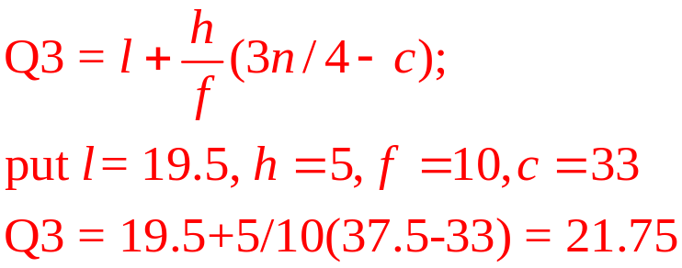
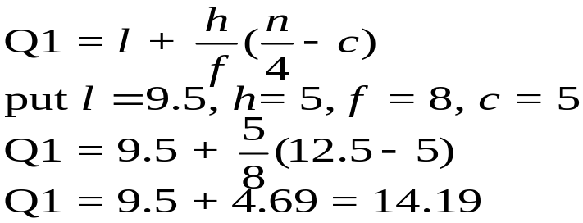
Example: The following data shows the frequency distribution of the salary of 50 employees of a firm. Calculate the following:
Inter quartile range and its coefficient
Semi inter quartile range and its coefficient
Salary (000) | Class boundary | f | cf
5-9 | 4.5-9.5 | 5 | 5
10-14 | 9.5-14.5 | 8 | 13
15-19 | 14.5-19.5 | 20 | 33
20-24 | 19.5-24.5 | 10 | 43
25-29 | 24.4-29.5 | 4 | 47
30-34 | 29.5-34.5 | 3 | 50
 |  | 50
To compute the required quantities, first we will find the group/class in which it will lie to occur.
For Q₁: n/4 = 50/4 = 12.5. It indicate the Q1 lies in the group (9.5-14.5).
For Q₃: 3n/4 = 3*50/4 = 37.5. It indicate the Q3 lies in the group (19.5-24.5).

Slide 7
IQR = Q3 – Q1
= 21.75 - 14.19 = Rs. 7.56
Coefficient of IQR = (Q3 – Q1)/(Q3 + Q1)
= (21.75 - 14.19 )/(21.75 + 14.19 )
= 7.56/35.94 = 0.21
SIQR = QD = (Q3 – Q1)/2 = (21.75 - 14.19 )/2
= 7.56/2 = Rs. 3.78
Coefficient of SIQR = (Q3 – Q1)/(Q3 + Q1)
= (21.75 - 14.19 )/(21.75 + 14.19 )
= 7.56/35.94 = 0.21

Slide 8
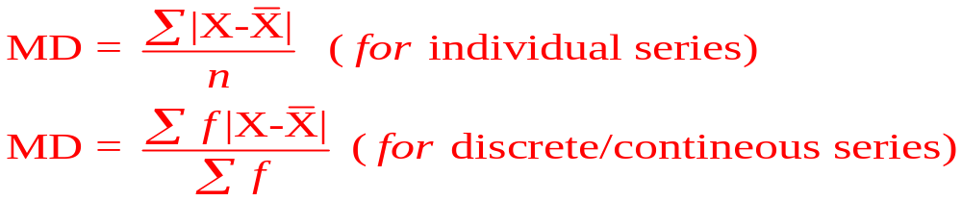
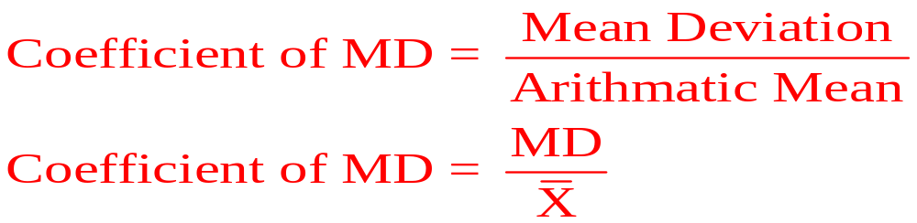
MEAN DEVIATION AND ITS COEFFICIENT
Mean deviation is an arithmetic mean of absolute deviations taken from any central value (mean, median, mode) of a data set. It is an absolute measure of dispersion. Mathematically, it can be defined as:
Its relative measure is called coefficient of mead deviation and can be expressed as:

Slide 9
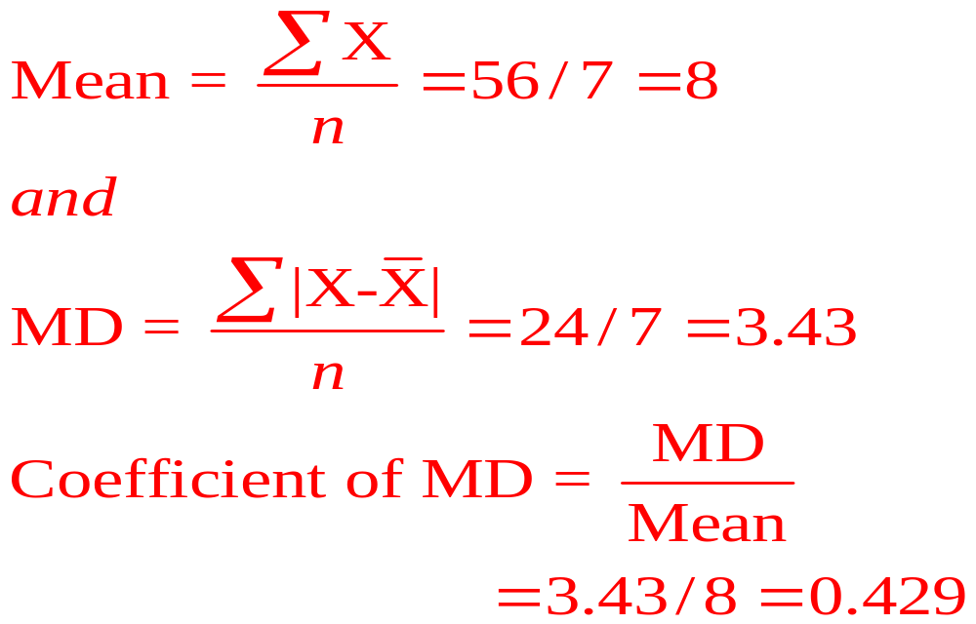
Example: The following data indicate the consumption (000) of 7 different households in a certain locality of Peshawar. Calculate Mean deviation and its coefficient.
2 | 4 | 6 | 8 | 10 | 12 | 14
X | (X-mean) | |X-mean |
2 | -6 | 6
4 | -4 | 4
6 | -2 | 2
8 | 0 | 0
10 | 2 | 2
12 | 4 | 4
14 | 6 | 6
56 |  | 24

Slide 10
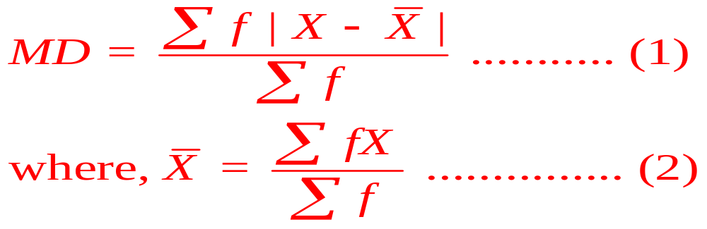
Numerical Example (Mean)
Using the following data showing the weights (in grams) of 60 apples, calculate the mean deviation from mean and its coefficient.
Weight | 65-84 | 85-104 | 105-124 | 125-144 | 145-164 | 165-184 | 185-204 | Total
Number of apples | 9 | 10 | 17 | 10 | 5 | 4 | 5 | 60
Necessary computations are given below:

Slide 11

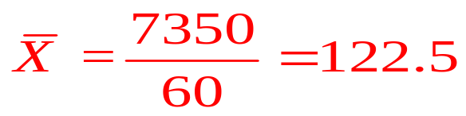
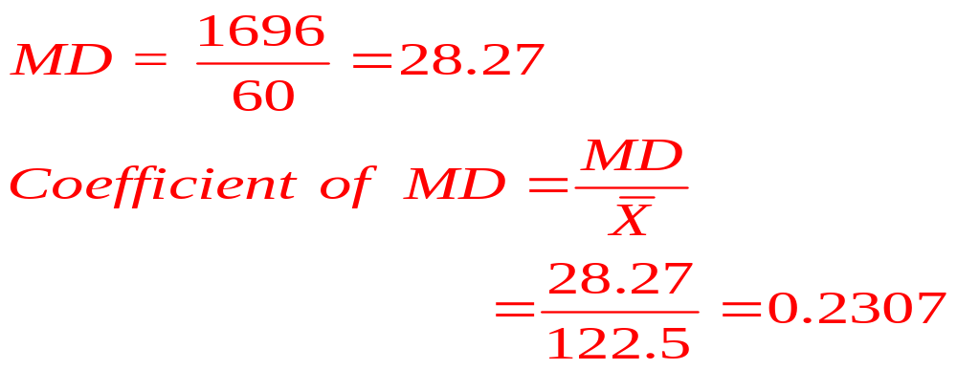
Weight | 65-84 | 85-104 | 105-124 | 125-144 | 145-164 | 165-184 | 185-204 | Total
Number of apples (f) | 9 | 10 | 17 | 10 | 5 | 4 | 5 | 60
Mid point (X) | 74.5 | 94.5 | 114.5 | 134.5 | 154.5 | 174.5 | 194.5
fx | 670.5 | 945 | 1946.5 | 1345 | 772.5 | 698 | 972.5 | 7350
 | 432 | 280 | 136 | 120 | 160 | 208 | 360 | 1696
So equation (2) becomes:
Using equation (1), we have:

Slide 12
Numerical Example (Mean)
Using the following discrete frequency distribution, showing the weights (in grams) of 60 apples, calculate the mean deviation from mean and its coefficient.
Weight | 74.5 | 94.5 | 114.5 | 134.5 | 154.5 | 174.5 | 194.5 | Total
Number of apples | 9 | 10 | 17 | 10 | 5 | 4 | 5 | 60
Try yourself by using the formula as used for grouped/continuous frequency distribution:

Slide 13
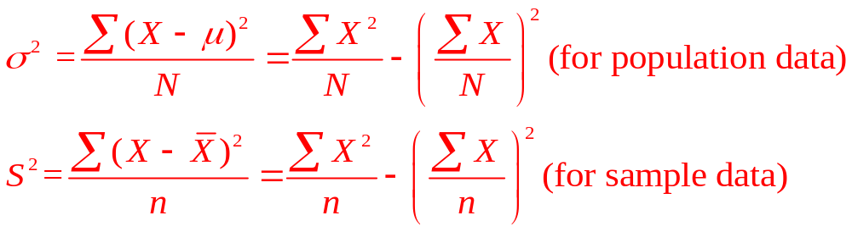
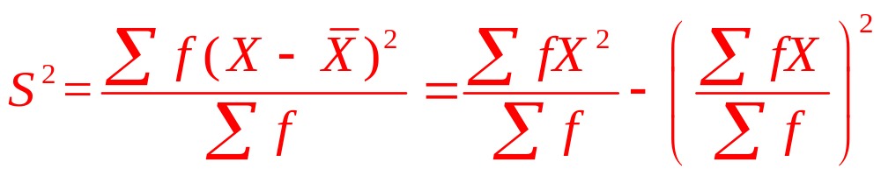
VARIANCE: Variance is the arithmetic mean of the squared deviation taken from mean. Mathematically, variance is defined as:
For frequency distribution (discrete or continuous), variance is expressed as:
It is important to mention that variance is always be positive number (or non-negative). It can not be a negative value.

Slide 14
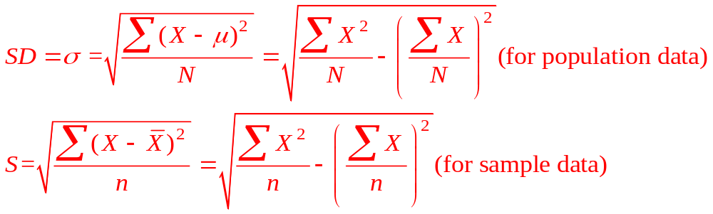
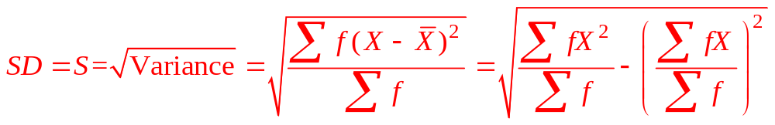
STANDARD DEVIATION: Standard deviation is the square root of variance and is expressed as, mathematically.
For frequency distribution (discrete or continuous), standard deviation is expressed as:
Note: Standard deviation will always be a positive number (or non-negative). It can not be a negative value. Standard deviation is an absolute measure of dispersion.

Slide 15
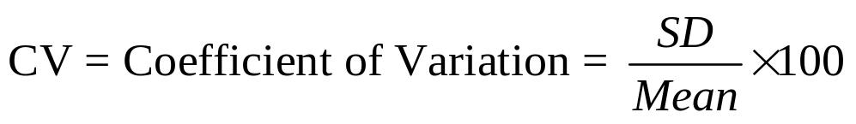
COEFFICIENT OF VARIATION:
Coefficient of variation, denoted by CV is a relative measure of dispersion and used for comparing the consistency to different data sets. It is the ratio of standard deviation to arithmetic mean and the result is expressed as percentage. Mathematically, CV is expressed as:
While comparing the two data sets (series) A and B, the series A is defined to be consistent than B if CV of series A is less than the CV of series B i.e.
CV_{A} < CV_{B}

Slide 16
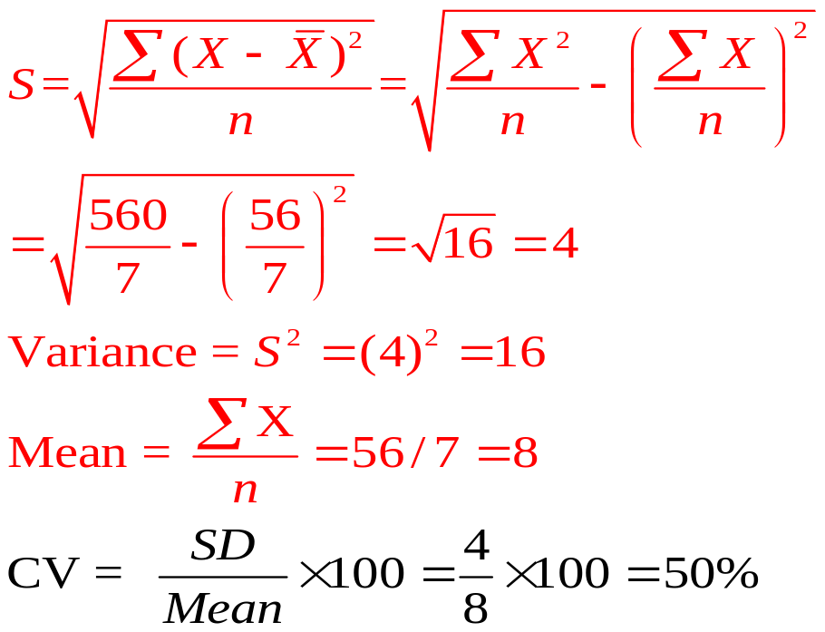

Example: The following data indicate the consumption (000) of 7 different households in a certain locality of Peshawar. Calculate standard deviation, variance, and coefficient of variation.
2 | 4 | 6 | 8 | 10 | 12 | 14
X | X²
2 | 4 | 36
4 | 16 | 16
6 | 36 | 4
8 | 64 | 0
10 | 100 | 4
12 | 144 | 16
14 | 196 | 36
56 | 560 | 112

Slide 17
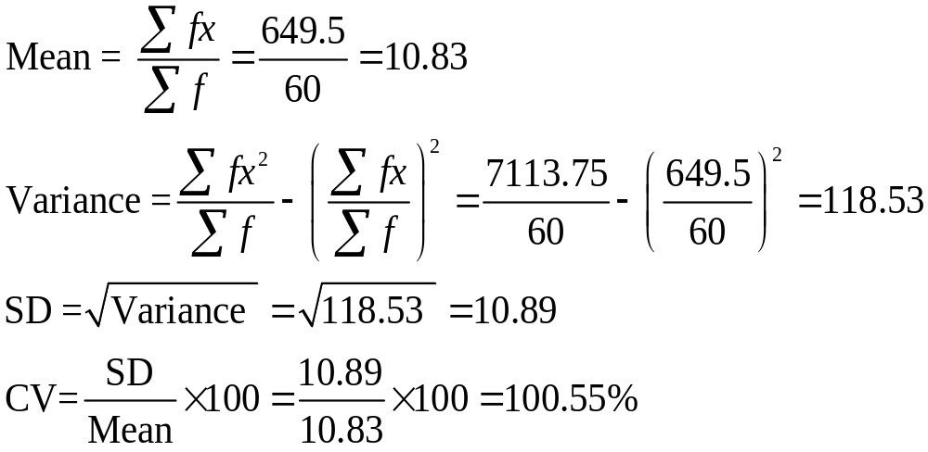
Example: The following data represent the monthly consumptions (in thousand of Rs.) of 60 students, selected from Abasyn University Peshawar. Calculate the average consumption of students, variance, standard deviation and coefficient of variation
Consumption (X) | 9.5 | 10 | 10.5 | 11 | 11.5 | 12 | 14 | Total
Number of students (f) | 9 | 10 | 17 | 10 | 5 | 4 | 5 | 60
fx | 85.5 | 100 | 178.5 | 110 | 57.5 | 48 | 70 | 649.5
fx² | 812.25 | 1000 | 1874.25 | 1210 | 661.25 | 576 | 980 | 7113.75

Slide 18
Example: Using the following data showing the sales in thousand of Rupees of 60 different shops in Peshawar city. Calculate the variance, standard deviation and coefficient of variation.
Sale (000) | 65-84 | 85-104 | 105-124 | 125-144 | 145-164 | 165-184 | 185-204 | Total
Number of shops | 9 | 10 | 17 | 10 | 5 | 4 | 5 | 60
TRY yourself

Slide 19
Example: The following data shows the score obtained by two different students (A & B) in five different subjects. State that which student has shown a consistent performance, by calculating CV for each.
Student-A | Student-B
60 | 70
80 | 75
70 | 65
75 | 70
55 | 70
75 | 65
415 | 415
X_{A} | X_{A}² | X_{B} | X_{B}²
60 | 3600 | 70 | 4900
80 | 6400 | 75 | 5625
70 | 4900 | 65 | 4225
75 | 5625 | 70 | 4900
55 | 3025 | 70 | 4900
75 | 5625 | 65 | 4225
415 | 29175 | 415 | 28775
Mean-A = 415/6 = 69.17
SD_{A}= 8.89
CV_{A} = 12.85%
Mean-B = 415/6 = 69.17
SD_{B}= 3.44
CV_{B} = 4.97
Since CV of Student B is less than the CV of student A, so the performance of Student B is consistent.

Slide 20
Example: The following data shows life time of refrigerators (in months) produced by two different companies (A & B). State that which company is consistent as compared to other one, regarding the life time of refrigerators.
Company-A | Company-B
60 | 70
80 | 75
70 | 65
75 | 70
55 | 70
75 | 65
415 | 415
X_{A} | X_{A}² | X_{B} | X_{B}²
60 | 3600 | 70 | 4900
80 | 6400 | 75 | 5625
70 | 4900 | 65 | 4225
75 | 5625 | 70 | 4900
55 | 3025 | 70 | 4900
75 | 5625 | 65 | 4225
415 | 29175 | 415 | 28775
Mean-A = 415/6 = 69.17
SD_{A}= 8.89
CV_{A} = 12.85%
Mean-B = 415/6 = 69.17
SD_{B}= 3.44
CV_{B} = 4.97
Since CV of Company-B is less than the CV of Company-A, so the performance of Company-B is consistent.

